Slide 1
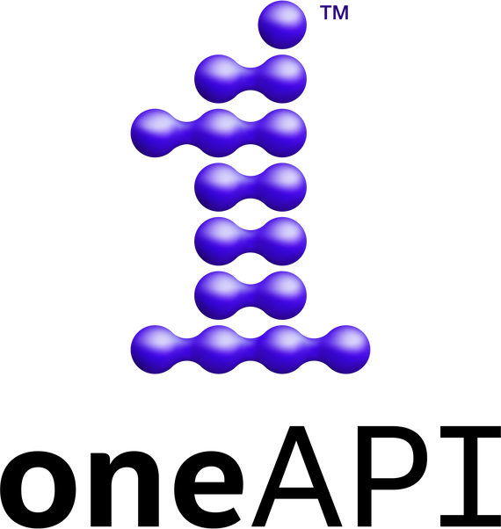


INTEL AI HACKATHON
Team Name: Code Commanders
TOPIC: Multimodal Mental Health Assessment Suite
Team members Names Email IDs Institution Name
Hariharan Bhaskaran | cb.sc.u4aie23030@cb.students.amrita.edu | Amrita Vishwa Vidyapeetham, CBE
MOPURU SAI BAVESH REDDY | cb.sc.u4aie23044@cb.students.amrita.edu | Amrita Vishwa Vidyapeetham, CBE
Suthekshan K | cb.sc.u4aie23067@cb.students.amrita.edu | Amrita Vishwa Vidyapeetham, CBE
Keerthivasan S V Team Lead | cb.sc.u4aie23037@cb.students.amrita.edu | Amrita Vishwa Vidyapeetham, CBE

Slide 2
Problem Statement
Increasing Prevalence of Mental Health Concerns: The number of people affected by mental health issues is on the rise, making it a pressing global concern.
Need for Early Detection Tools: There is a critical need for tools that can detect signs of deteriorating mental health and depression early on, to initiate timely interventions.
Aim to Maintain a Healthy Community: The goal is to foster a community where mental health is understood, prioritized, and cared for.
Lack of Accessible Tools: Many existing mental health assessment tools are not easily accessible to everyone, especially those in remote areas or those who cannot afford regular therapy sessions.
Stigma Associated with Mental Health: There is still a significant stigma associated with mental health issues, which can prevent individuals from seeking help.
Inadequate Understanding of Mental Health: There is a lack of understanding and awareness about mental health in many communities, leading to misdiagnosis and ineffective treatment plans.
Need for Personalized Care: Mental health conditions vary greatly from person to person. Therefore, there is a need for personalized assessment and care plans.
Integration of Multimodal Data: There is a lack of tools that effectively integrate multimodal data (like video, audio, and text) for a comprehensive mental health assessment.

Slide 3
1. Solution:
Multimodal Mental Health Assessment Suite: A comprehensive tool for assessing mental health conditions using multimodal data.
Objective: To provide a nuanced understanding of mental health conditions, aiding in more accurate diagnostics and treatment planning.
Components: The suite will analyze:
Video data: Facial expressions and body language.
Audio data: Speech patterns and tonality.
Standard scales: Utilize existing mental health assessment scales.
Benefits: This approach allows for a more holistic understanding of the patient’s condition, potentially uncovering nuances that single-mode assessments might miss.
2. Method:
Data Collection: Gather video, audio, and written responses from patients during interviews.
Data Analysis: Use Natural Language Processing (NLP) for analyzing patient interviews and written responses, and Computer Vision (CV) for analyzing facial expressions and body language.
Integration: Combine the results from NLP and CV analyses to provide a comprehensive assessment of the patient’s mental health condition.
Personalized Care: Use the assessment results to develop personalized care plans for each patient.
Continuous Monitoring: The system can be used for continuous monitoring of the patient’s condition, providing real-time updates to healthcare providers.
3. Intel tool kits used:
Intel Distribution of OpenVINO Toolkit: For deploying AI models, especially computer vision tasks to analyze facial expressions and body language.
Intel AI Analytics Toolkit: It can help in analyzing and processing the data efficiently.
Intel DevCloud: For testing and developing the models with access to Intel’s CPUs, GPUs, and FPGAs.
Intel Deep Learning Boost: This can be used to accelerate AI inference workloads, including the analysis of video and audio data.

